Slide 1
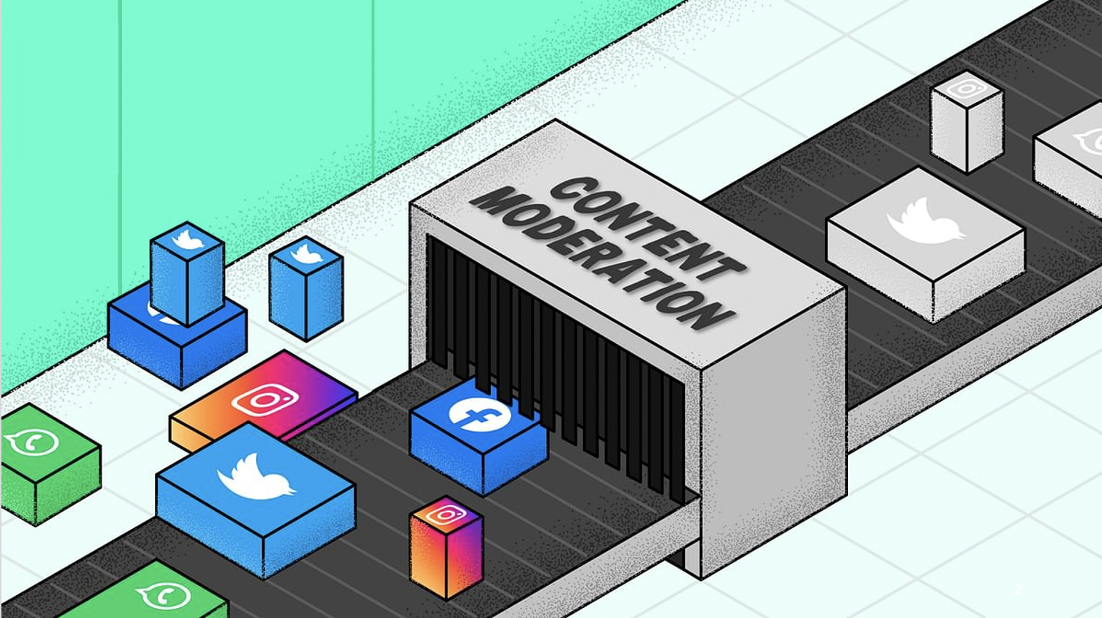


Designing Transparent & Effective Content Moderation
Presented by
Shagun Jhaver

Slide 2
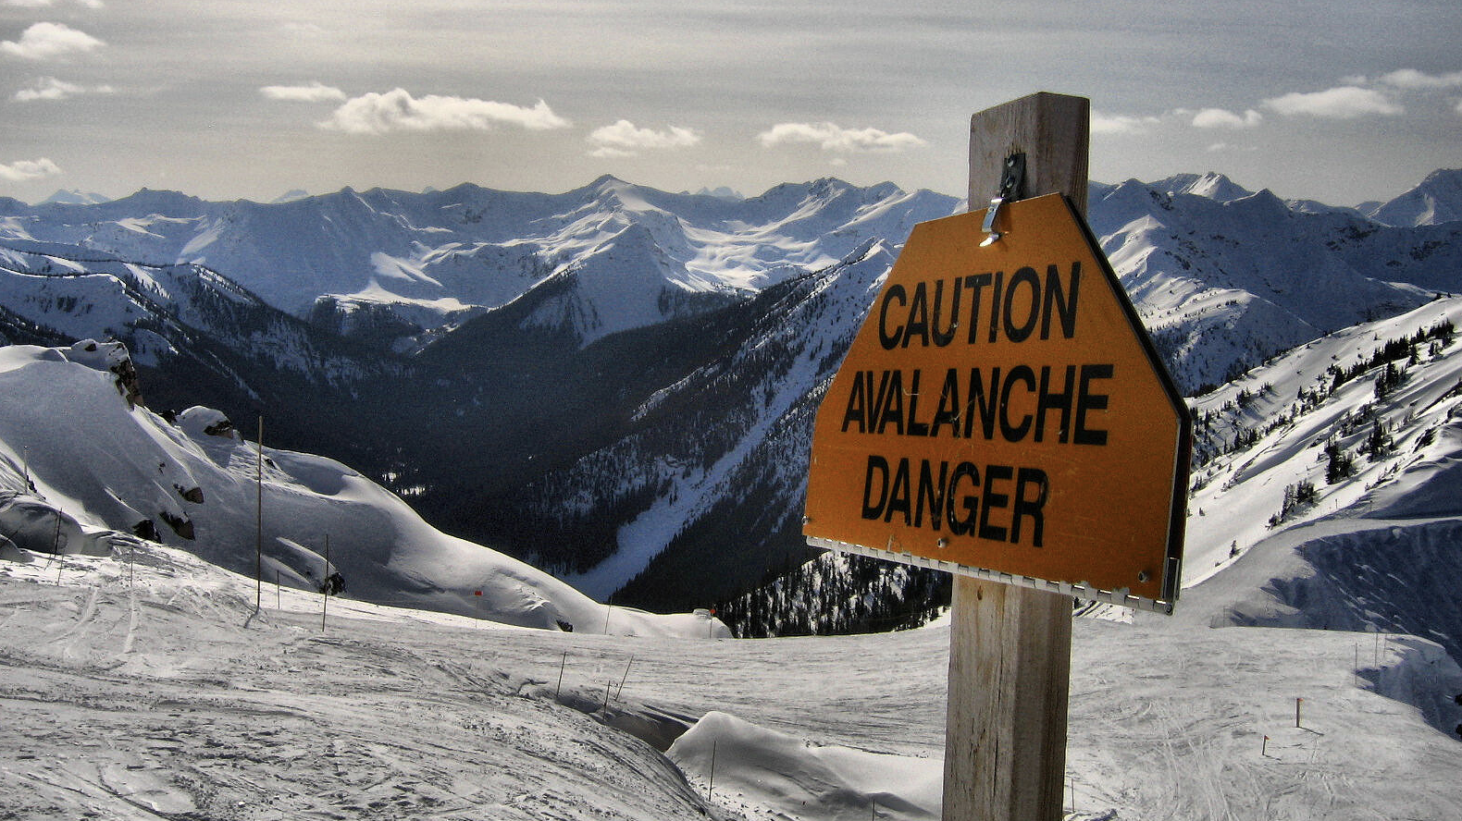
Caution: disturbing content
Notes:
Thank you for that Introduction, and thanks for inviting me!
So before I begin, I want to caution that some of the slides in this talk contain offensive language and images, so I apologize for that, but this content was important to include in order describe the specifics of this research.

Slide 3
Will You Allow This On Your Site?
#STAB AND BECOME THE FEAR OF THE ZIONIST
SOMEONE SHOOT TRUMP!
LET’S BEAT UP FAT KIDS!
I HOPE SOMEONE KILLS YOU!
Content Moderation
Notes:
I will start today with a thought exercise.
Let’s suppose that you create a new social media website. What type of comments will you allow on that site?
If someone posts this comment, will you allow it or remove it?
How about this comment?
What if someone posts this?
How about this?
It turns out that making decisions like these about which posts to allow and which to remove is a fundamental service that all social media platforms like Facebook, Twitter and Reddit provide. This service is called content moderation.

Slide 4


Facebook’s Internal Rulebook for Content Moderation
#STAB AND BECOME THE FEAR OF THE ZIONIST
SOMEONE SHOOT TRUMP!
LET’S BEAT UP FAT KIDS!
I HOPE SOMEONE KILLS YOU!
Notes:
Now these four comments are actually examples from Facebook’s internal rulebook for content moderation. This rulebook was leaked a while ago, and according to this rulebook, the top 2 comments should be allowed and the bottom 2 comments should be removed. Now this is what Facebook would do, but other platforms may have different criteria for what is appropriate, and they may make different moderation decisions on these comments.
As a researcher, I am interested in examining how social media platforms make these moderation decisions, and how these decisions impact end-users.

Slide 5

Build a foundation for designing
transparent and effective content moderation systems
Notes:
The main goal of my research is to

Slide 6
Background
Background
Transparency
Effectiveness
Current Directions
Notes:
Now, here is the agenda for my talk today
I will begin with offering a background on content moderation.
Next, I will describe my research on transparency in content moderation
Next, I will discuss my work on evaluating the effectiveness of moderation interventions.
Finally, I will conclude with detailing the current directions in which I am expanding my research.

Slide 7
Transparency
Background
Transparency
Effectiveness
Current Directions
Notes:
Now, here is the agenda for my talk today
I will begin with offering a background on content moderation.
Next, I will describe my research on tranparency in content moderation
Next, I will discuss my work on evaluating the effectiveness of moderation interventions.
Finally, I will conclude with detailing some future directions of my research.

Slide 8
Effectiveness
Background
Transparency
Effectiveness
Current Directions
Notes:
Now, here is the agenda for my talk today
I will begin with offering a background on content moderation.
Next, I will describe my research on transparency in content moderation
Next, I will discuss my work on evaluating the effectiveness of moderation interventions.
Finally, I will conclude with detailing some future directions of my research.

Slide 9
Current Directions
Background
Transparency
Effectiveness
Current Directions
Notes:
Now, here is the agenda for my talk today
I will begin with offering a background on content moderation.
Next, I will describe my research on tranparency in content moderation
Next, I will discuss my work on evaluating the effectiveness of moderation interventions.
Finally, I will conclude with detailing some future directions of my research.

Slide 10
Background

Slide 11
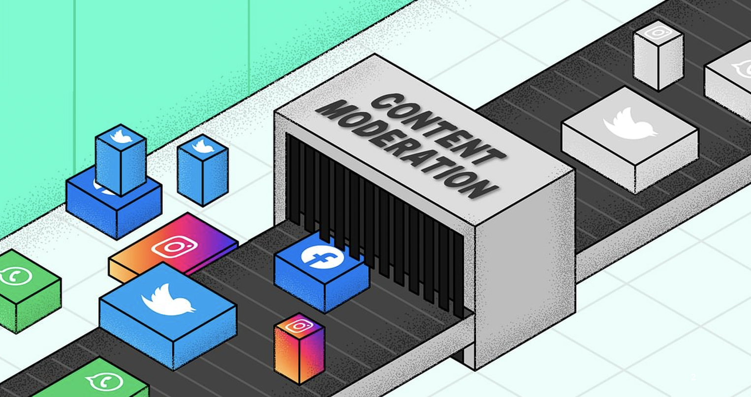
Background
What is Content Moderation?
Organized practice of screening user-generated content posted to Internet sites in order to determine its appropriateness for that site (Roberts 2017)
A complex sociotechnical system
Admins
Community guidelines
Moderators
Moderation bots
Users
Roberts, Sarah (2017) Content Moderation. Encyclopedia of Big Data.
Notes:
Content moderation is enacted by a rich and complex sociotechnical system.
First, it has a small group of admins. These admins are platform employees who make high-level decisions about how moderation should work.
Then, there are community guidelines which are a set of rules that dictate how users should behave.
Then there are moderators who enforce these community guidelines. These moderators are at the frontline and they make low-level moderation decisions about which posts should be removed or which users should be banned.
These moderators work with a wide variety of automated tools to make their job easier.
Finally, there are end-users who flag content that violates community guidelines, and this flagged content is reviewed by the moderators.
All these different components interact with one another in complicated ways and help constitute content moderation systems.

Slide 12
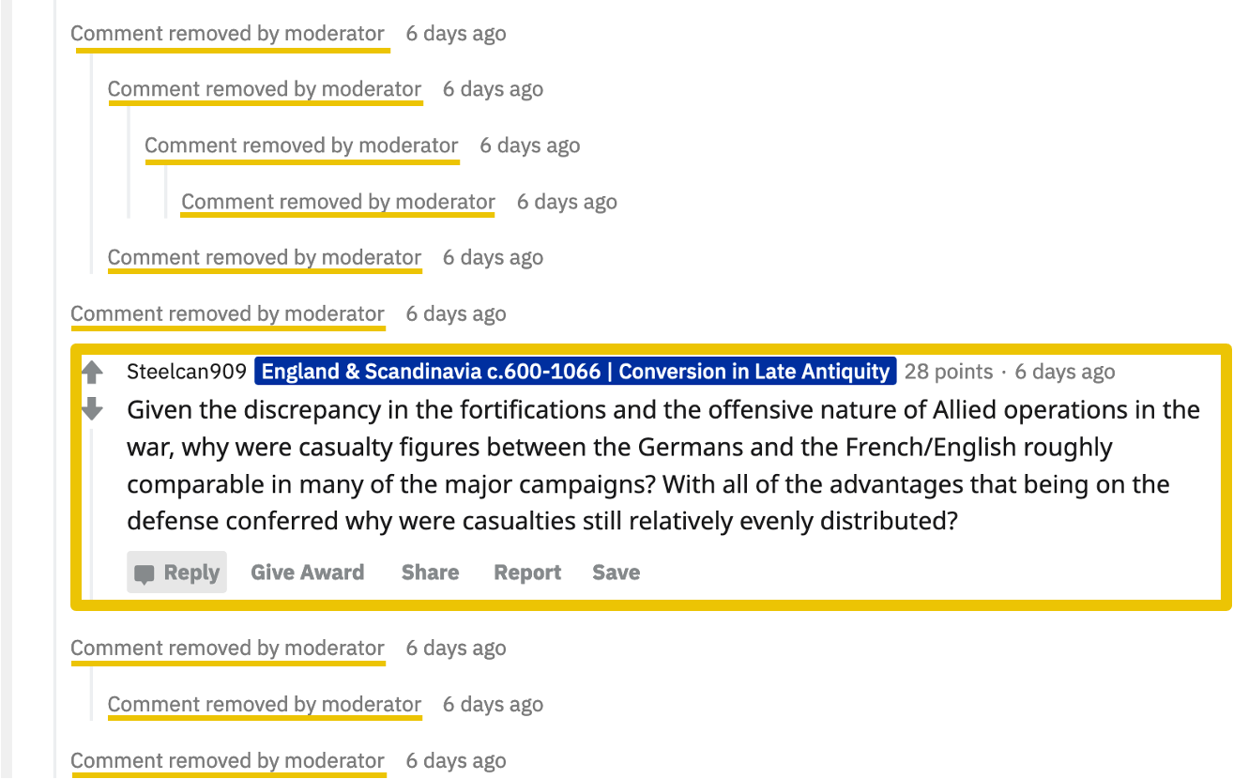
Background
It helps users find relevant information
Notes:
it removes irrelevant comments and makes it easier for the users to find the information they are looking for.

Slide 13
Background
It helps users find relevant information
Notes:
it removes irrelevant comments and makes it easier for the users to find the information they are looking for.

Slide 14
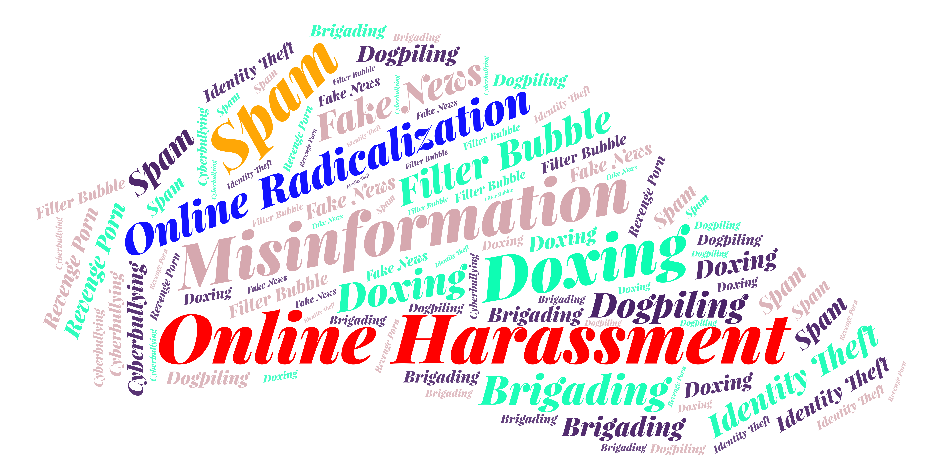
Background
It addresses key problems on the internet
Notes:
Content moderation is responsible for addressing many of the key problems that social media platforms face today.

Slide 15

Background
It shapes who gets heard
Notes:
At the same time, content moderation is critical to determining which groups’ voices get heard, and whether minorities and other vulnerable groups feel comfortable participating online.

Slide 16
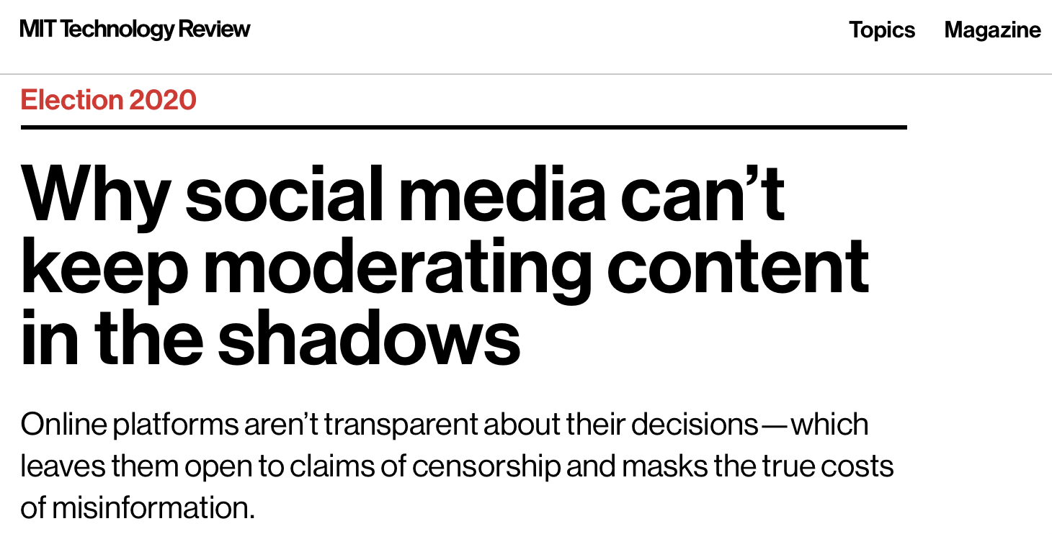
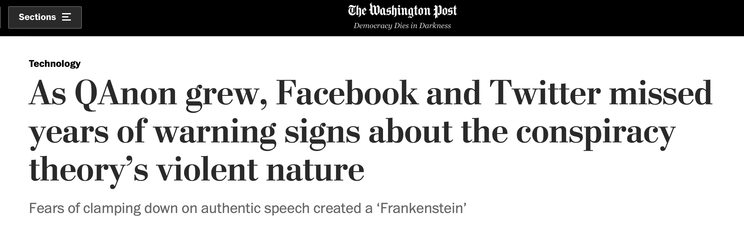
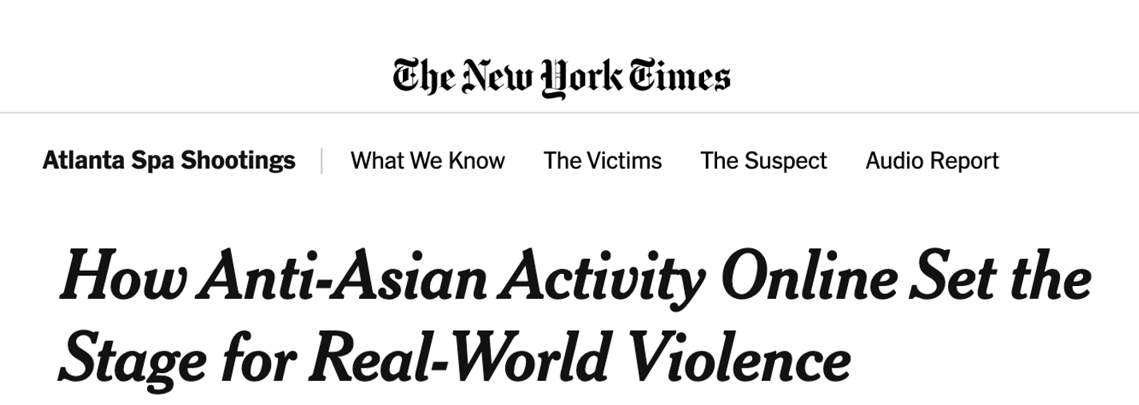
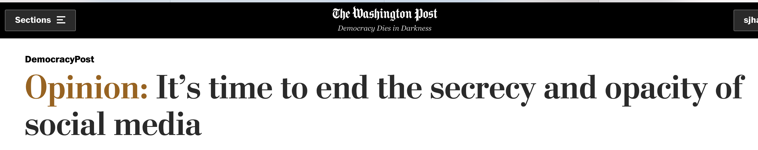
Background
Content Moderation is broken
Lack of Transparency
Online Hate Groups
Urgent need to address these failures

Slide 17
Background
My Approach
Understand moderation needs, perspectives and practices of end-users
Participant observation, surveys, interviews, network analyses
Building, deploying and testing experimental systems
Study how users behave in response to content moderation
Systematic log analyses of platform data
Topic modeling, machine learning, regression analyses, causal experiments

Slide 18
Background
Two Aspects of Content Moderation
Transparency
Effectiveness
Transparency about content removals
Current moderation systems are punitive
Little effort in explaining what went wrong
Should moderators provide transparency?
Effectiveness in addressing the rise of online hate groups
Platforms use a variety of approaches
How can we evaluate the effectiveness of moderation approaches?

Slide 19

Background
Contributions
Transparency
Transparency
Improvement in User Attitudes
Part 1
Transparency
Improvement in User Behaviors
Effectiveness
Design friction can be an effective moderation strategy to limit the influence of toxic communities
Part 2

Slide 20
Transparency

Slide 21
Transparency
Why is Transparency Important?
Platforms should respect human rights (Suzor et al. 2018*)
Freedom of expression
Due process
Due process is hurt by lack of transparency
Users cannot make sense of content takedowns
Difficult to seek remedy
* Nicolas Suzor, Tess Van Geelen, and Sarah Myers West. 2018. Evaluating the legitimacy of platform governance: A review of research and a shared research agenda. International Communication Gazette 80, 4 (2018), 385–400.
Notes:
There is a growing push by scholars and activists for platforms to have a responsibility to respect human rights. This includes providing freedom of expression to users. This also means that platforms should provide due process for the users’ appeals against moderation decisions.
because when there is a lack of transparency, users cannot detect or make sense of content takedowns.
This makes it difficult for users to seek remedy for wrong decisions

Slide 22
Transparency
Improving Transparency
Explanations

Slide 23
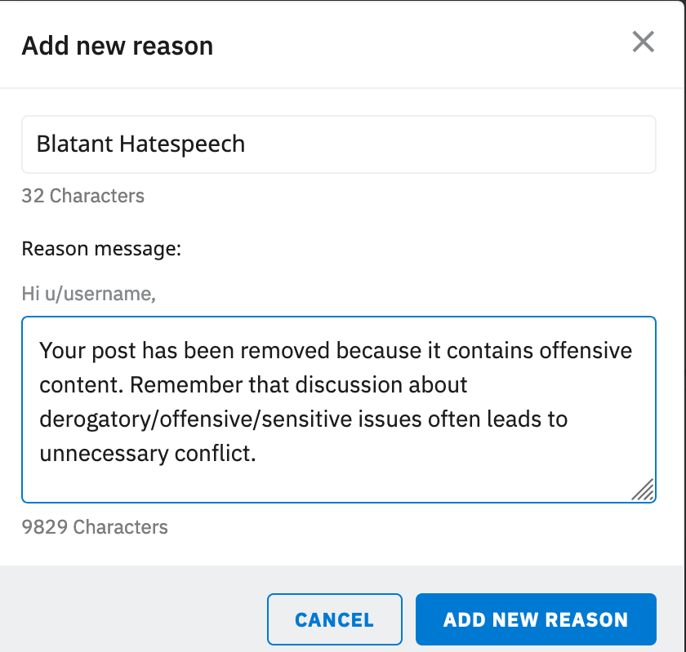
Transparency
Potential Role of Explanations
Help users learn from mistakes
Curating Explanations
COST
Notes:
This brings up the question:

Slide 24
Transparency
Should Moderators Provide Removal Explanations?
Notes:
Should moderators provide explanations?
And this is the central question I ask in the first part of this talk.
Is it worth it for moderators to spend their time and efforts into providing explanation for post removals?
Can such explanations improve user attitudes and behaviors?

Slide 25

Transparency
Notes:
To answer this, I turned to the popular social media platform Reddit

Slide 26

Transparency
Why Reddit?
1000’s of sub-communities
Variety of approaches to content moderation
Rich site to study how differences affect attitudes and behavior
Notes:
I chose Reddit because
Reddit is made up of thousands of communities, and these communities show a variety of approaches to enacting content moderation.
Therefore, the Reddit platform provides a rich site to study how the differences in moderation approaches affect the attitudes and behaviors of users differently.

Slide 27
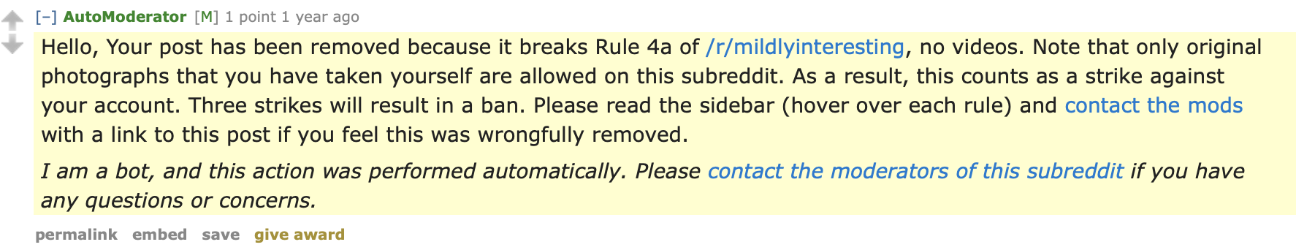
Transparency
Explanation Comment Example
Notes:
This is what an explanation comment on Reddit looks like
This comment was posted as a reply to a submission that was removed.
and it provides user an explanation of exactly why their post was removed.
It warns the user that if they continue to violate rules, their account will be banned.
It also informs the user that if they believe that the removal is mistaken, they con contact the moderators of the subreddit.

Slide 28


Transparency
Research Questions
RQ 1: Attitudes
How is providing removal explanations associated with user attitudes?
RQ 2: Behaviors
How is providing removal explanations associated with future behaviors?
Survey
Data Mining
Notes:
Given this context, I pose the following research questions.
My first question is about attitudes. I ask,

Slide 29
Transparency: Study 1
RQ 1: Attitudes
How is providing removal explanations associated with user attitudes?
Transparency: Study 1
“Did you Suspect the Post Would be Removed?”
Understanding User Reactions to Content Removals on Reddit
Shagun Jhaver, Darren Scott Appling, Eric Gilbert, Amy Bruckman
CSCW 2019
(Best Paper Honorable Mention Award)

Slide 30
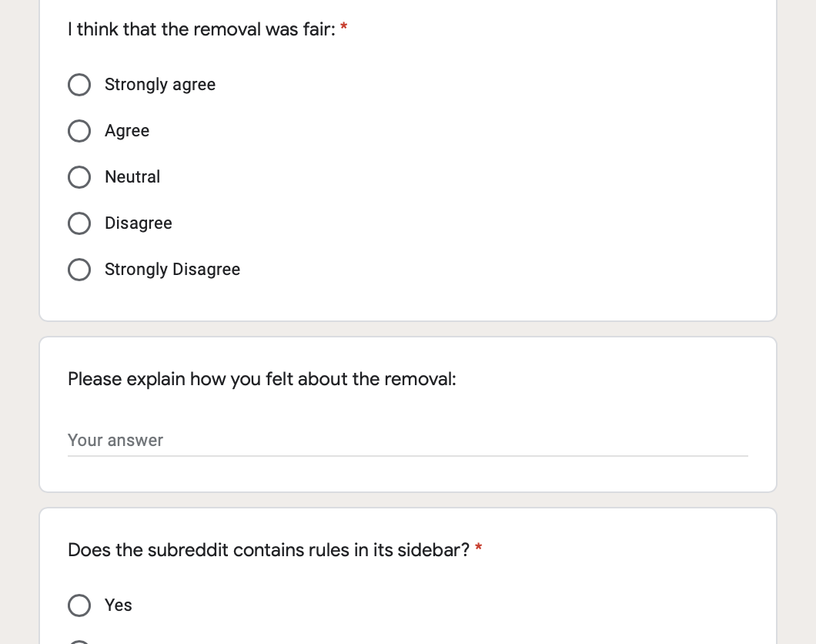
Transparency: Study 1
Survey
907 Reddit users who experienced content removals

Slide 31
Transparency: Study 1
Survey Questions
Multiple Choice Questions
Regression analyses
Open-ended Questions:
e.g., “Please explain how you feel about the post removal”
Inductive analysis

Slide 32
Transparency: Study 1
RQ1: Attitudes
How is providing removal explanations associated with user attitudes?
Fairness
Desire to Post Again
Perceptions of fairness of post-removal
Attitude about posting again in the future
Q - I think that the removal was fair:
Strongly Agree
Agree
Neutral
Disagree
Strongly Disagree
Q – How likely are you to post again on this subreddit after this experience?
Very likely
Likely
Neutral
Not likely
Very unlikely
Notes:
I focused on two aspects of user attitudes
that I will refer to as Fairness
I derived information about both of these user attitudes through survey questions

Slide 33
Transparency: Study 1
RQ1: Attitudes
How is providing removal explanations associated with user attitudes?
Fairness
Desire to Post Again
Perceptions of fairness of post-removal
Attitude about posting again in the future
Linear Regression
Dependent Variables
Notes:
I developed linear regression models to analyze the relationship between different variables, and I used fairness and Desire to Post again as my dependent variables

Slide 34
Transparency: Study 1
Control Variables
Demographics (collected through survey)
Age
Education
Gender
Prior History (collected using Reddit API)
Reddit karma (popularity metric)
Time on Reddit (in days)
Number of submissions posted on Reddit

Slide 35
Transparency: Study 1
Findings

Slide 36
Transparency: Study 1
Q1: Before you started this survey, did you know that your post was removed?
Notes:
I want to note here whether or not users are aware of their post removal is an important aspect of transparency in content moderation.
Surprisingly, I found that 41.8% of users did not even know that
In fact, I received dozens of replies to my invitation messages where users expressed surprise about their post removals.

Slide 37


Transparency: Study 1
Awareness of Post Removal
Fairness
Desire to Post Again
(β = 0.265***)
(Not Significant)
***: p < .001
Notes:
My regression analyses show that when users become aware of their post removals, perhaps through communication by the moderation team, they are more likely to consider the moderation of their post as fair than when they are not made aware.
Noticing removals, however, did not have any statistically significant effect on whether participants consider it likely they will post in the future.

Slide 38


Transparency: Study 1
Users care about being notified of post removals
TAKEAWAY

Slide 39
Transparency: Study 1
Q2: Did you receive an explanation for why your post was removed?:
Yes
No

Slide 40
Transparency: Study 1
Receiving Explanation
Fairness
Desire to Post Again
(β = 0.384***)
(β = 0.088*)
*: p < .05 ***: p < .001

Slide 41
Transparency: Study 1
Receiving explanations is linked to improvement in user attitudes
TAKEAWAY

Slide 42

Transparency: Study 1
Dissatisfaction About the Lack of Transparency
The removal is ok, it doesn’t bother me, but it’s not ok that I didn’t get informed.
– P838

Slide 43
Transparency: Study 1
Q3: The explanation was provided by
Unsure
Yes
Bot
Human
No

Slide 44
Transparency: Study 1
Explanation Source
Fairness
Desire to Post Again
(Not Significant)
(Not Significant)

Slide 45
Transparency: Study 1
Humans don’t have an advantage over bots in improving user attitudes
TAKEAWAY

Slide 46
Transparency: Study 1
Some Users Self-Identify as Trolls
Deliberately violate rules
Receiving removal explanations does not matter

Slide 47
Transparency: Study 1
Some users self-identify as trolls
I will always post stupid things on the Patriots subreddit until they ban me because I hate the Patriots.
– P579
Notes:
This indicates that it may be important to distinguish trolls from other users, and not waste moderation resources on trolls.

Slide 48
Transparency: Study 1
Contributions
Transparency: Study 1
Part 1
Transparency
Improvement in User Attitudes
How is transparency associated with improvements in future behaviors?

Slide 49
Transparency: Study 2
RQ 2: Behaviors
How is providing removal explanations associated with future behaviors?
Transparency: Study 2
“Does Transparency in Moderation Really Matter?”
User Behavior after Content Removal Explanations on Reddit
Shagun Jhaver, Amy Bruckman , Eric Gilbert
CSCW 2019
(Best Paper Award)

Slide 50
Transparency: Study 2
Data Preparation
32M Submissions
Reddit Corpus
Mar – Oct 2018
80M posts
<user, subreddit> Pairs
4.7M pairs
subsample
for each pair
H(user, subreddit)
Post History
Mar – Oct 2018

Slide 51
Transparency: Study 2
RQ 2: Behaviors
How is providing removal explanations associated with user behavior?
H(user, subreddit)
Post History (Mar – Oct 2018)
Splitting Post History
Past Posts
Future Posts
H(user, subreddit)_{past}
Mar – June 2018
H(user, subreddit)_{future}
July – Oct 2018
Independent Variables
Dependent Variables

Slide 52
Transparency: Study 2
RQ 2: Behaviors
How is providing removal explanations associated with user behavior?
Future Removal (u, s)
Does user u have a future post in subreddit s that is removed?
Logistic Regression
Dependent Variable
Notes:
I focused on one specific aspect of user behavior.
I tracked for each <u, s> pair, whether the user u has a future submission in subreddit s that is removed, and I call this variable Future Removal.
Proxy
Now this is a binary variable, so I built logistic regression models to analyze the relationships between different independent variables and Future Removal, which I considered to be my DV.

Slide 53
Transparency: Study 2
Control Variables
Subreddit Variables
# Subreddit Subscribers
# Subreddit Submissions
Net Subreddit Removal Rate
Post History Variables
Past Submissions by user u in subreddit s
Avg. Past Score
Avg. Past Comments

Slide 54
Transparency: Study 2
Findings

Slide 55
Transparency: Study 2
Explanation Rate
Proportion of removed posts that received explanations
Explanation Rate
Future Removals
(6.5% lower odds***)
Nagelkerke R Square = 0.187
***: p < .001x

Slide 56
Transparency: Study 2
Explanations are linked to
improved user behaviors
TAKEAWAY

Slide 57
Transparency: Study 2
Explanation by Bot Rate
Proportion of explanations that are provided by bots
Explanation by Bot Rate
Future Removals
(Not Significant)
Nagelkerke R Square = 0.231

Slide 58
Transparency: Study 2
Humans don’t have an advantage over bots in improving user behaviors
TAKEAWAY

Slide 59
Transparency
Contributions
Transparency
Transparency
Improvement in User Attitudes
Part 1
Transparency
Improvement in User Behaviors

Slide 60
Transparency
Implications
Transparency is a key concern for moderated users
Users care about being notified of post removals
Users care about receiving explanation for post removals

Slide 61

Transparency
Implications
Human mods have no advantage over bots for improving user attitudes or user behaviors
Opportunity for deploying tools for explanation
Explainable AI

Slide 62

Transparency
Implications
Moderation should shift from a strictly punitive model to an educational model
Notes:
This research also suggests a need for paradigm shift in content moderation
Platforms should work with community members, educating them about the community norms and turning them into valuable contributors

Slide 63
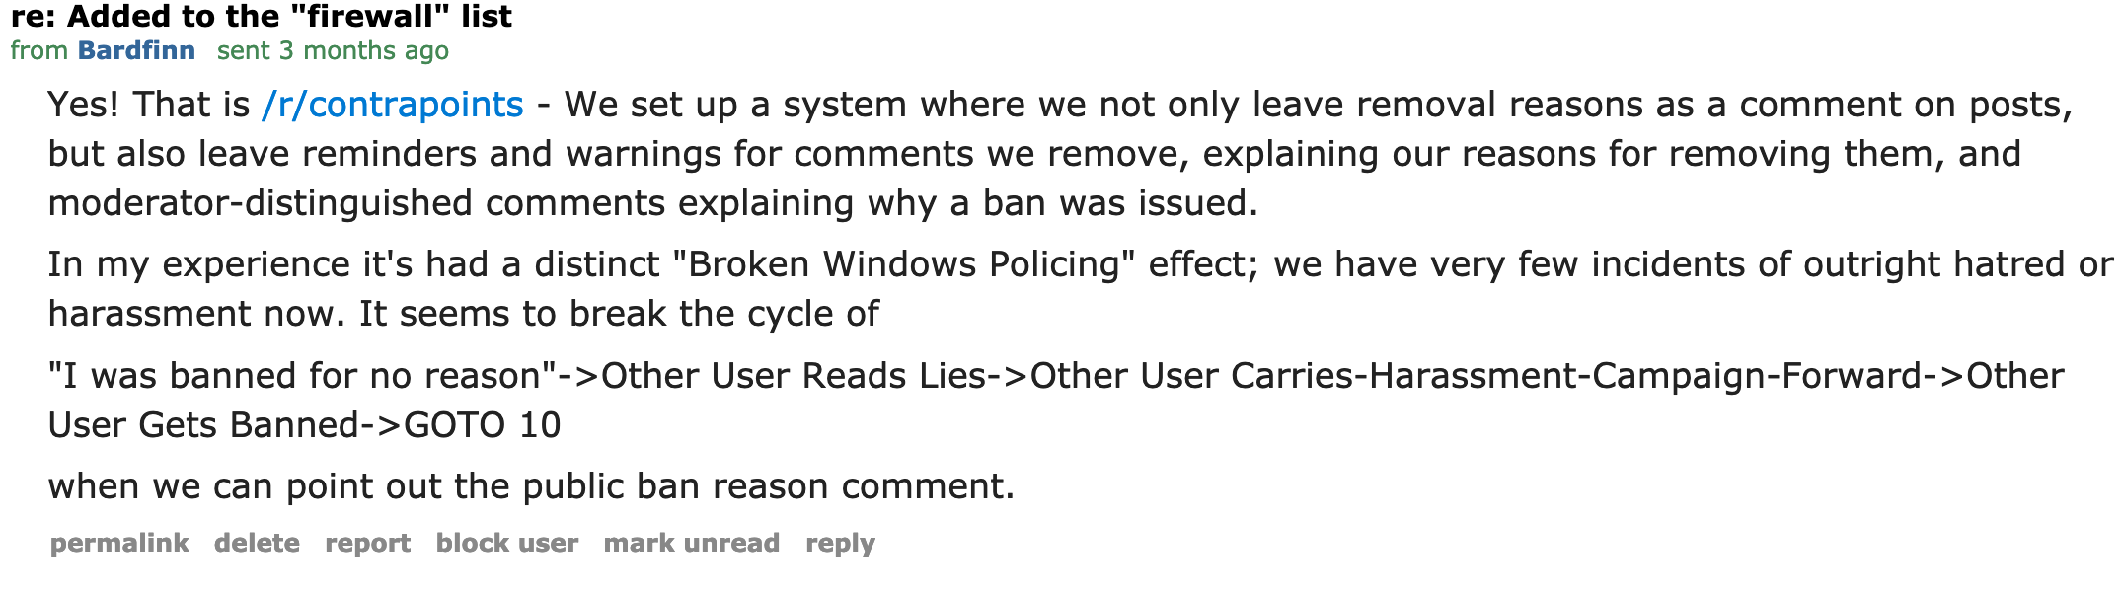
Transparency
Impact
Direct Impact on Communities
Moderators began offering removal explanations
r/contrapoints subsequently reduced hatred

Slide 64

Transparency: Study 3
Impact
Collaboration with Twitch
Incorporate fairness and transparency in content moderation for millions of users

Slide 65
Transparency
Removal Explanations
Attitudes
Behaviors
Example of
Mixed-Methods Analyses
z
Insights into social needs
Improve behaviors
Notes:
So in this work, I have focused on one design choice, the provision of removal explanations, and discussed how it relates to user attitudes and behaviors. But this provides a concrete example of how my mixed-methods analysis approach can help us obtain nuanced insights into
And going forward, I want to continue using such mixed-methods approaches to inform the design of online communities.

Slide 66
Effectiveness

Slide 67
Effectiveness
Effectiveness of Moderation Sanctions
Rise of hate groups and their links to offline violence
Platforms use a variety of approaches to address this
Focus: Evaluate the Effectiveness of these approaches
Metrics:
Posting activity levels
Racism, misogyny and toxicity levels
Radicalization of new individuals
Notes:
In recent years,

Slide 68
Effectiveness
Moderation sanctions
User-level
sanctions
Community-level
sanctions
Quarantining
on Reddit
Computational frameworks
for analyzing the effectiveness

Slide 69
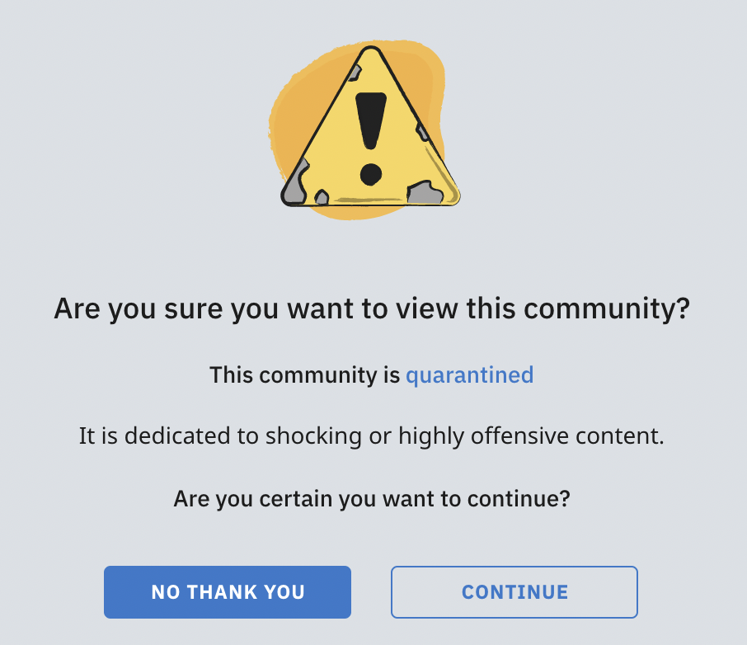
Effectiveness
Quarantining on Reddit
Visitors need to explicitly opt-in to view
Protects freedom of speech
Design friction:
Intentionally adding points of difficulty during users’ interaction with technology
Design friction as a moderation strategy
Serves as a warning before the ban

Slide 70
Effectiveness: Study 1
RQ: New user influx
How does quarantining affect the influx of new users to quarantined subreddits?
Effectiveness: Study 1
Quarantined! Examining the Effects of a Community-wide
Moderation Intervention on Reddit
Shagun Jhaver, Eshwar Chandrasekharan, Amy Bruckman, Eric Gilbert
(Under review at CSCW)

Slide 71
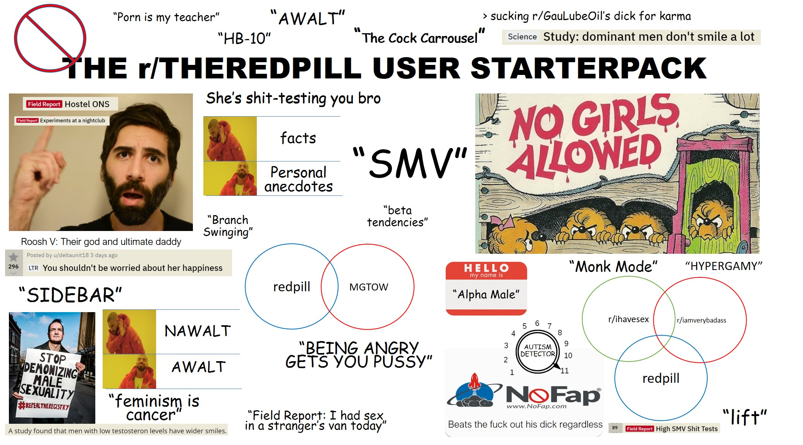
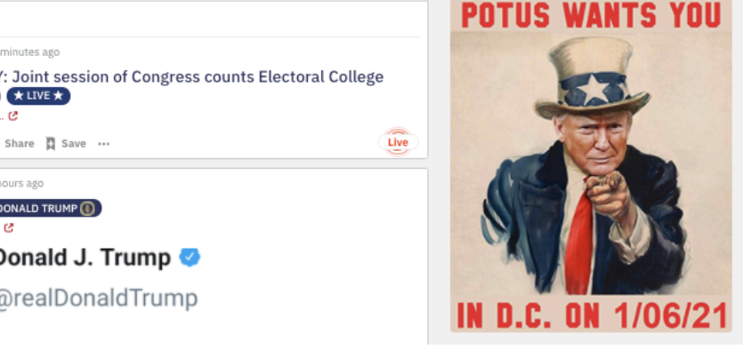
Effectiveness: Study 1
Two Largest Quarantined Subreddits
r/TheRedPill
Misogyny
Anti-feminist discourse
250K subscribers
r/TheDonald
Racism
Far-right discourse
750K subscribers

Slide 72
Effectiveness: Study 1
Data Preparation
85M Reddit Posts
r/TheRedPill
r/The_Donald
100 control subreddits
100 control subreddits
For each subreddit
Collect posts six months before to six months after quarantine
Daily influx of new users
Notes:
I wanted to see if the activity patterns in the treatment subreddits are different than other similar subreddits
I wanted to select control subreddits in such a way that the only difference between treatment and control subreddits was that the treatment subreddits were quarantined and the control subreddits were not quarntined.
For this, I selected as my control subs the communities where users of the r/TheRedPill and r/The_Donald were the most frequent contributors.

Slide 73
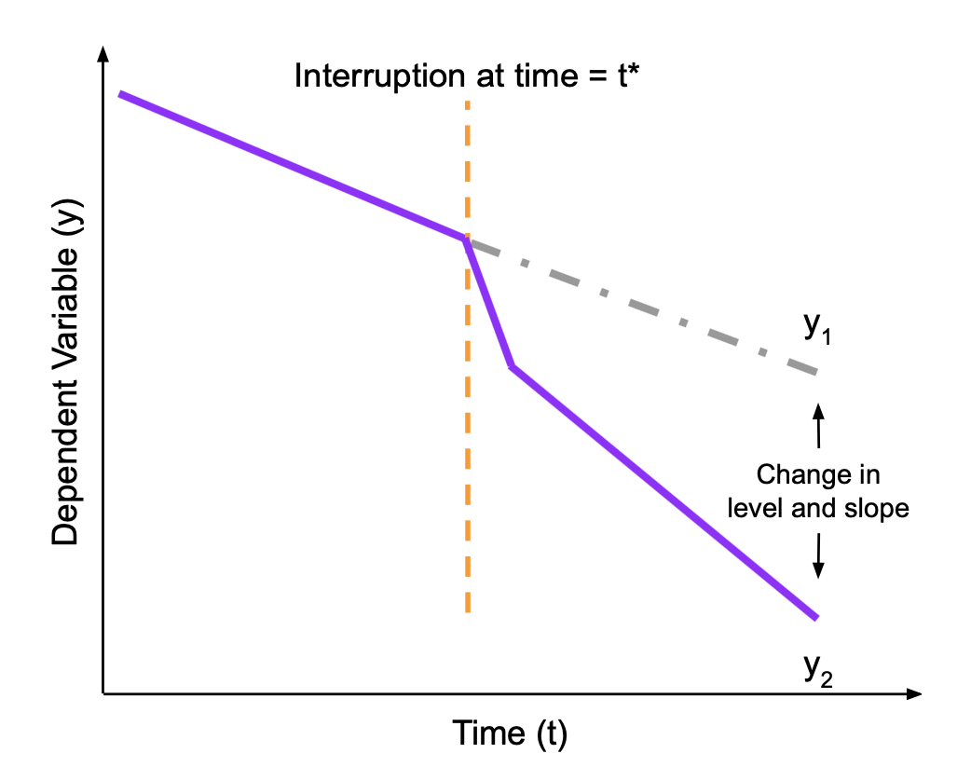
Effectiveness: Study 1
Methods
Interrupted Time-series (ITS) Analysis
Accounts for ongoing temporal trends within subreddits
Calculated β (degree of change in DV per unit increase in IV)
Bootstrapping Tests
Multiple simulations to compute β distribution for control subreddits
Examine whether β(TheRedPill) or β(The_Donald) is extreme in related to control distribution
Notes:
Tracked whether there is a Reddit-wide trend

Slide 74
Effectiveness: Study 1
Findings

Slide 75
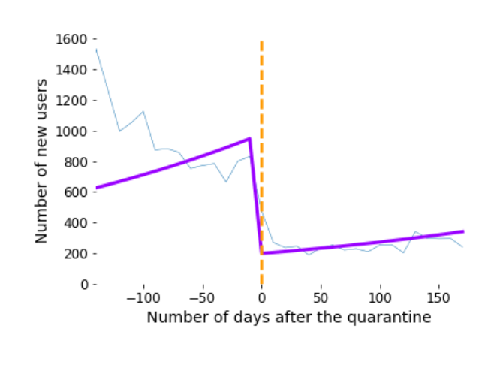
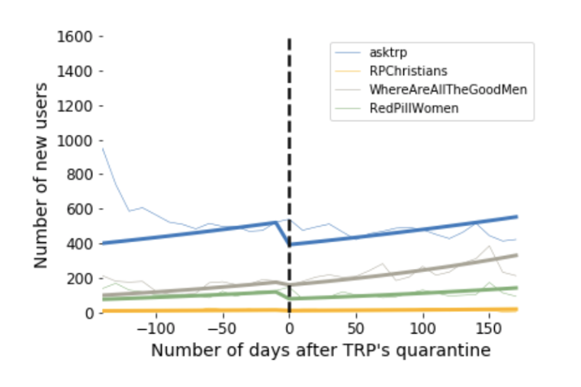
Effectiveness: Study 1
Sharp Decrease in the Influx of New Users
r/TheRedPill
Control Subreddits

Slide 76
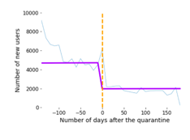
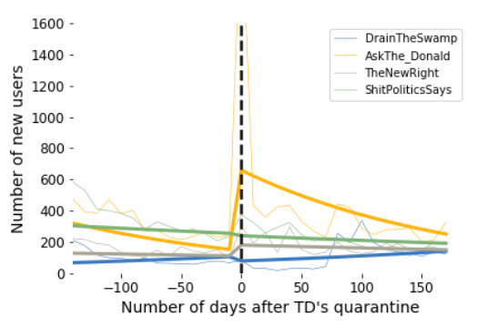
Effectiveness: Study 1
Sharp Decrease in the Influx of New Users
r/The_Donald
Control Subreddits

Slide 77
Effectiveness: Study 1
Sharp Decrease in the Influx of New Users
ITS analysis:
r/TheRedPill: β = -1.58***
r/The_Donald: β = -.87***
Bootstrapping analysis:
Significant drops in both r/TheRedPill and r/The_Donald
***: p < .001
Notes:
My numbers from the ITS analysis and bootstrapping analyses also confirmed

Slide 78
Effectiveness: Study 1
Quarantining curbs the growth of online hate groups
TAKEAWAY

Slide 79

Effectiveness: Study 2
Migration to Other Websites After Bans
Notes:
I employed quasi-experimental setups, including user matching and re

Slide 80
Effectiveness: Study 2
Migration to Other Websites After Bans
RQ: What happens when users migrate from banned Reddit communities to other platforms with laxer moderation?
Data: 7 million posts from:
Two banned Reddit communities
Standalone websites where Reddit users migrated to
Methods: Quasi-experimental setups
User-matching
Regression discontinuity designs
Results
Banning reduces the activity levels and influx of new users
Users become significantly more negative, toxic and hostile
Manoel Horta Ribeiro, Shagun Jhaver, Savvas Zannettou, Jeremy Blackburn, Emiliano De Cristofaro, Gianluca Stringhini, and Robert West. “Does Platform Migration Compromise Content Moderation? Evidence from r/The_Donald and r/Incels.”
Accepted at Computer Supported Cooperative Work (CSCW) 2021
Notes:
I employed quasi-experimental setups, including user matching and re

Slide 81
Effectiveness: Study 2
Moderation on mainstream platforms affects the growth of hate groups on other websites
TAKEAWAY

Slide 82
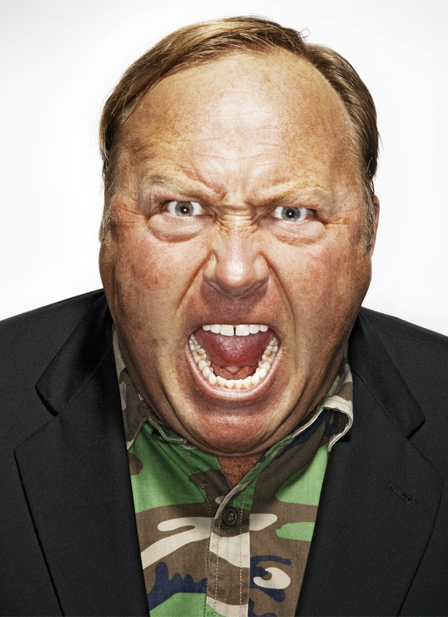
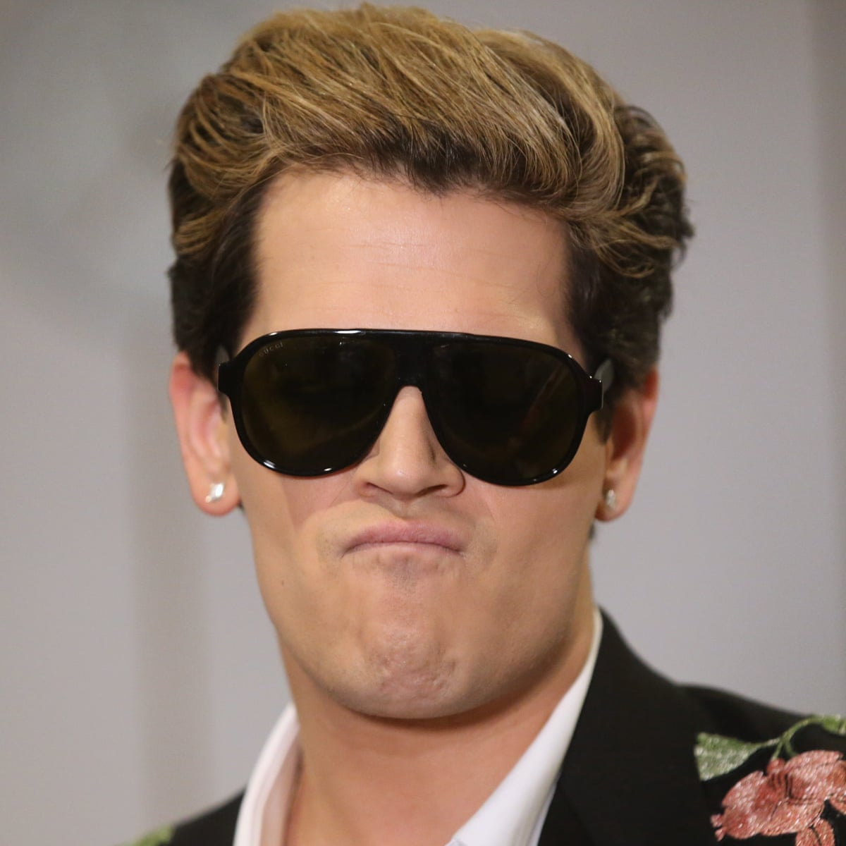
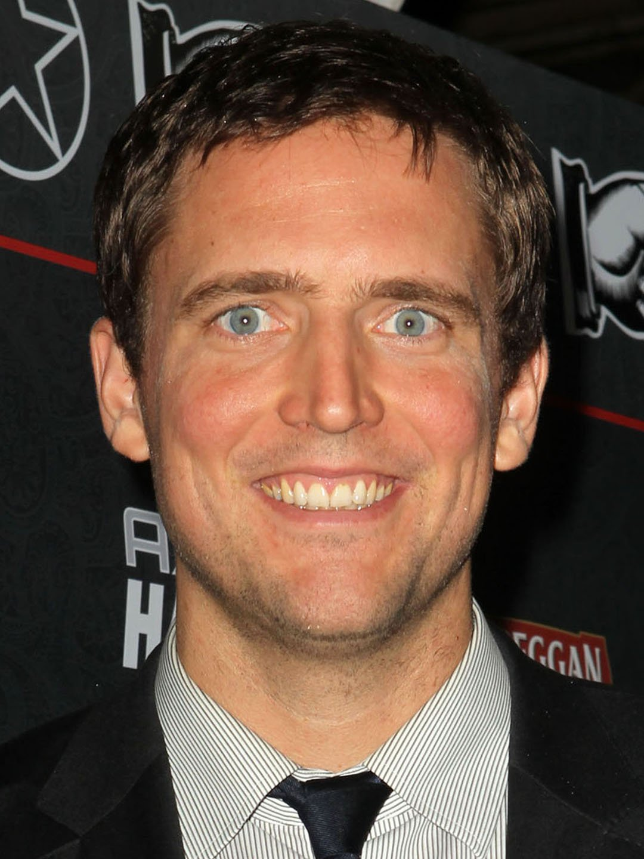
Effectiveness: Study 3
Deplatforming on Twitter
Alex Jones
Milo Yiannopoulus
Owen Benjamin
Shagun Jhaver, Christian Boylston, Diyi Yang, and Amy Bruckman. “Evaluating the Effectiveness of Deplatforming as a Moderation Strategy on Twitter.” Under Review at Proceedings of the ACM Human-Computer Interaction (CSCW).

Slide 83
Effectiveness: Study 3
Deplatforming on Twitter
RQ: How does deplatforming affect the spread of influencers’ ideas and the activities of their supporters in the long run?
Data: 49 million tweets
Referencing Alex, Milo and Owen/posted by their supporters
Submitted within six months before and after deplatforming
Methods:
Machine learning
Interrupted time-series regression analysis
Wilcoxon signed-rank tests
Results:
Deplatforming reduces the popularity of anti-social ideas
Deplatforming reduces the overall activity & toxicity levels of supporters
Shagun Jhaver, Christian Boylston, Diyi Yang, and Amy Bruckman. “Evaluating the Effectiveness of Deplatforming as a Moderation Strategy on Twitter.” Under Review at Proceedings of the ACM Human-Computer Interaction (CSCW).

Slide 84
Effectiveness: Study 3
Deplatforming offensive influencers can be effacious in counteracting offensive speech
TAKEAWAY

Slide 85
Effectiveness
Implications
Causal frameworks to evaluate the impact of moderation strategies
Adapt to evaluate other moderation interventions
Open-source code
Empower moderators to evaluate their own practices
Toward building a theory for effective moderation interventions

Slide 86
Effectiveness
Implications
Highlights the potential of using design friction as a moderation strategy
Effective compromise between censoring offensive speech and preserving freedom of expression
Opens up a new design space for interventions to curb the rise of online hate groups

Slide 87
Research Overview

Slide 88




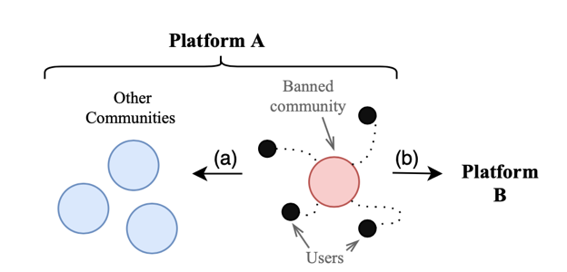



Research Overview
Transparency
Effectiveness
User attitudes
User behavior
Transparency
Quarantining
Deplatforming
Migrations
Content Moderation
Online Harassment
Enacting Content Moderation
Defining
Current moderation
Restorative Justice
Human-m/c collaboration
Blocklists
Streaming
Notes:
I have defined online harassment and identified different tactics of online harassment
I have also studied how we can use restorative justice framework to address online harassment.
This framework has been used offline to rehabilitiate prison populations and I have explored how we can implement this framework on social media sites to rehabilitate offenders as well as support victims of online harassment.
Moderation on many social platforms have a lot in common with the US government works. So I am exploring what we can learn from theories of offline governance like federalism and polycentricity to improve content moderation

Slide 89
Current Directions

Slide 90
Current Dirs.: Area 1
Multi-level Governance in Online Social Platforms

Slide 91
Current Dirs.: Area 1
Multi-level Governance in Online Social Platforms
Existing Literature
Current Practice
Decentralized governance in
institutional contexts, including in
nations and formal organizations
Examples of online platforms
that incorporate decentralization
What do we already know?
What remains to be explored?

Slide 92



Current Dirs.: Area 2
Combating Online Radicalization & the Rise of Hate Groups
Glorification and trivialization of violence
Visual or textual means that are ambiguous
Memes and visual cultures target outgroups like ethnic minorities, women, and the LGBTQ community
Identify sources of violent narratives in Chan cultures
Textual and Visual analysis
NLP methods, image comparison algorithms (e.g., DBSCAN), and digital ethnography

Slide 93
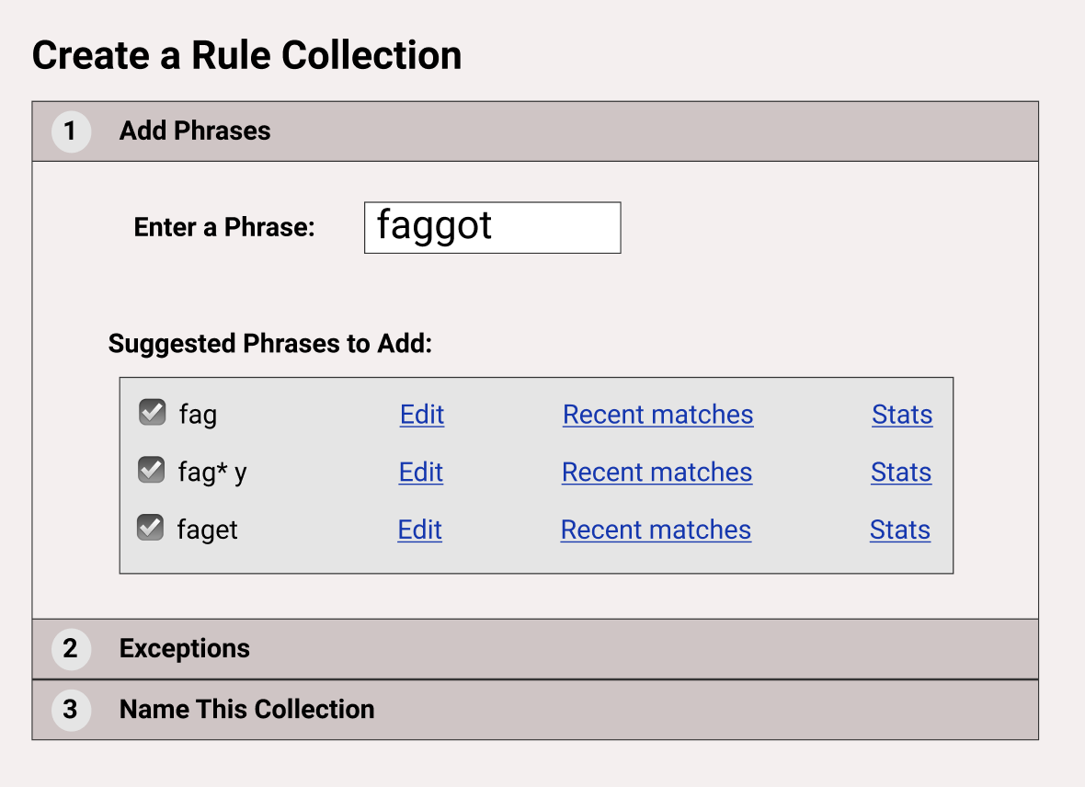
Current Dirs.: Area 3
Building Human-Centered AI Tools to Address Online Harassment
Tools for YouTube creators
Interviewed 20 YouTube creators
Designing tools to provide more autonomy to creators
Help creators configure regular expressions for blocking inappropriate comments

Slide 94
Current Dirs.: Area 3
Building Human-Centered AI Tools to Address Online Harassment
Machine learning models to create categories of offensive content
Configure automated actions for each category
Share models and build on top of others’ work
Adapt techniques to address problems in online social systems
Human-machine collaboration tools that improve the efficacy of volunteer moderation work

Slide 95














































Notes:
These are some of the lovely people from across academic institutions and industry who I have worked with on my research projects

Slide 96

Designing Transparent & Effective Content Moderation
Transparency
Transparency
Improvement in User Attitudes
Part 1
Transparency
Improvement in User Behaviors
Effectiveness
Design friction can be an effective moderation strategy to limit the influence of toxic communities
Part 2
Presented by
Shagun Jhaver
@shagunjhaver

Slide 97
Bonus Slides

Slide 98
Data collection goals
Transparency: Study 1
Submission should be recent
Enough time for moderators to review post
Survey request sent 3-10 hours
after post submission
Notes:
Enough time should have passed for moderators to review post

Slide 99
Transparency: Study 1
Sample recent Reddit posts
PRAW API
Posted within
past 12 hours?
Wait for
3 hours
If yes
…
Check removal status
Automated
data collection
If removed
Invite Poster to Participate

Slide 100
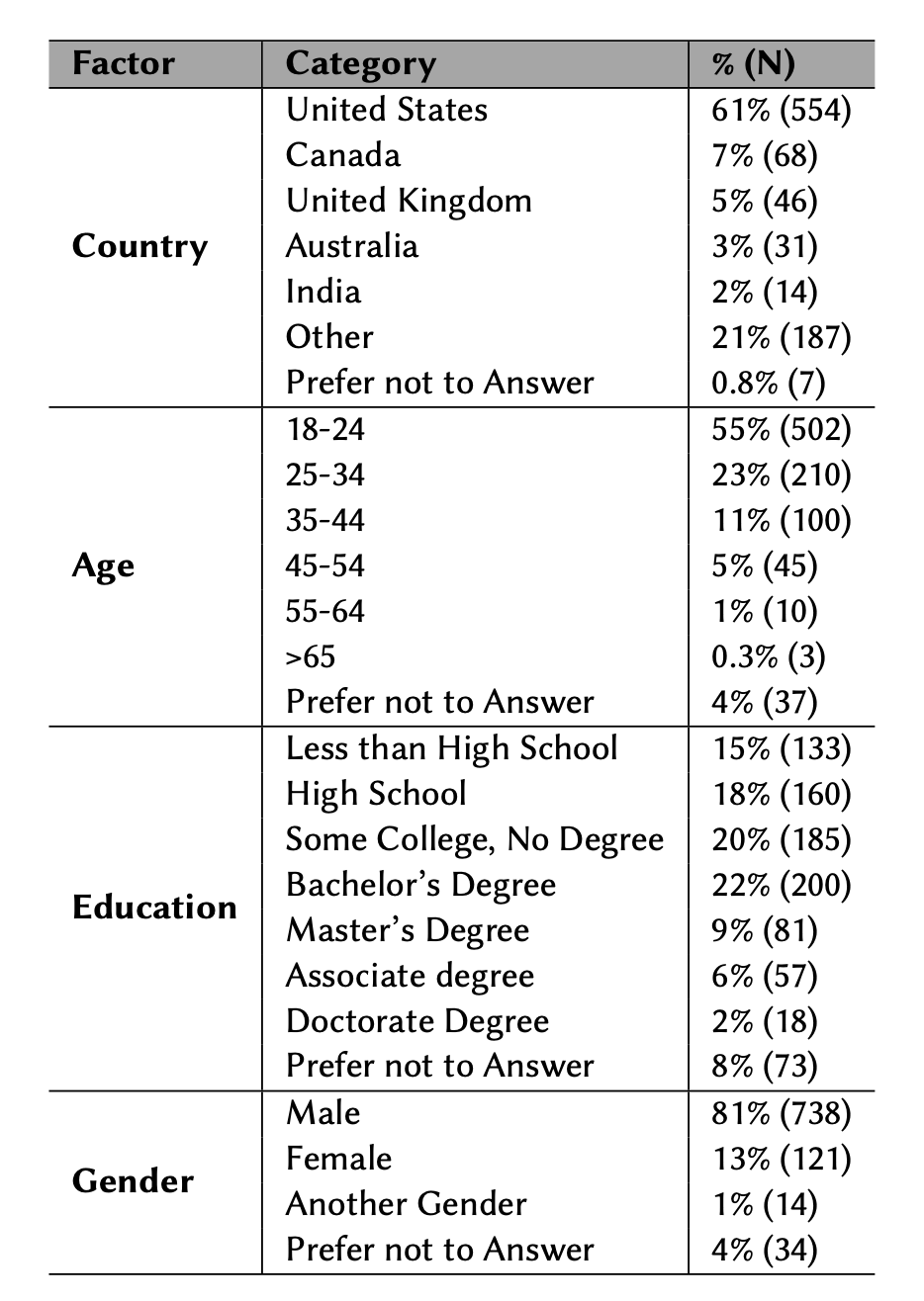

Slide 101
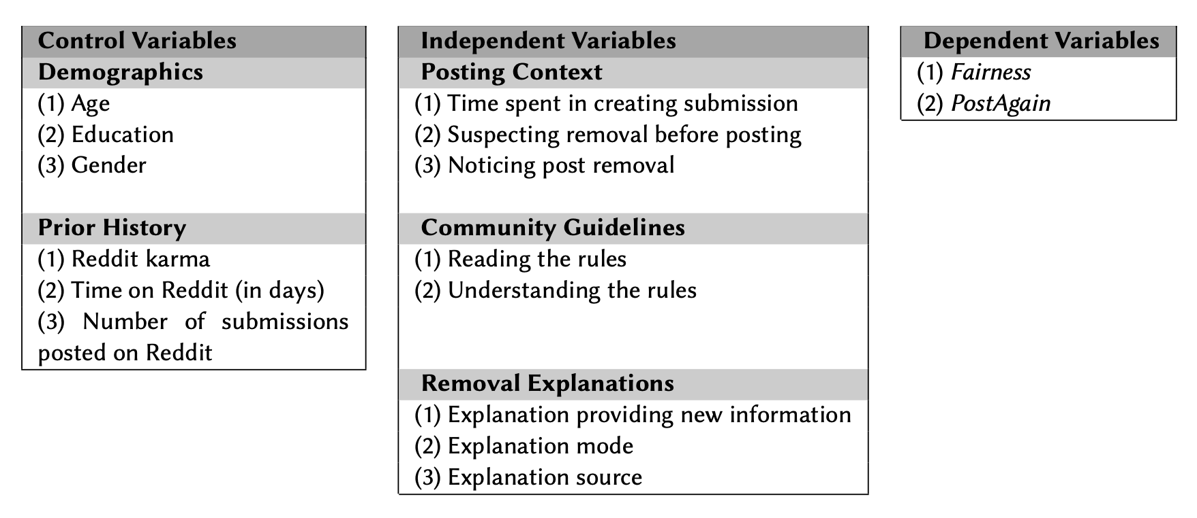

Slide 102
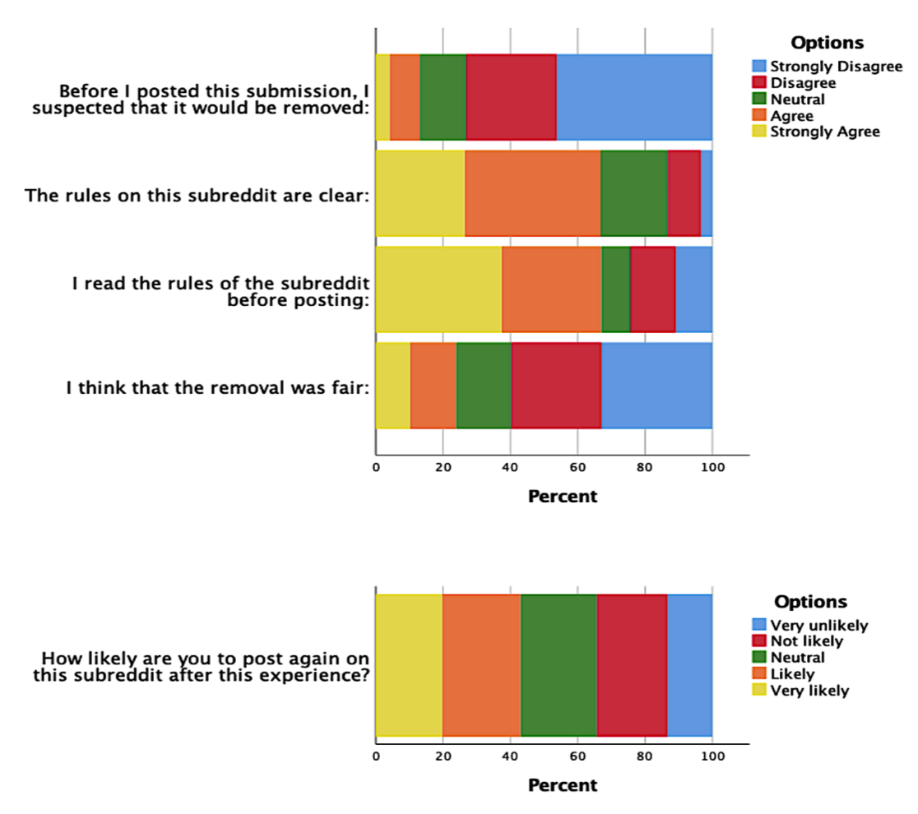

Slide 103
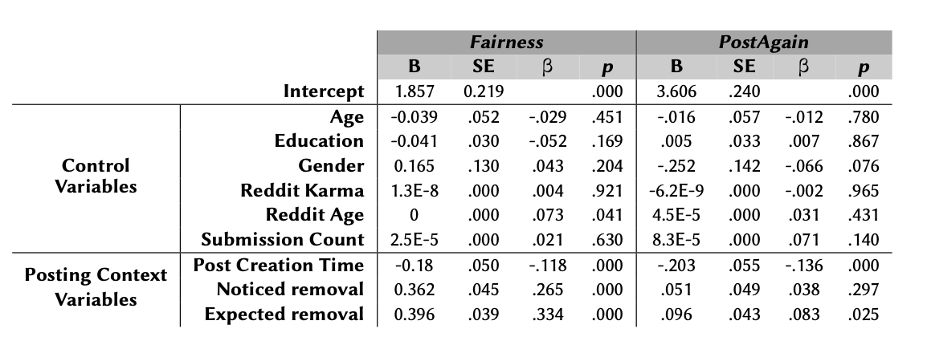

Slide 104
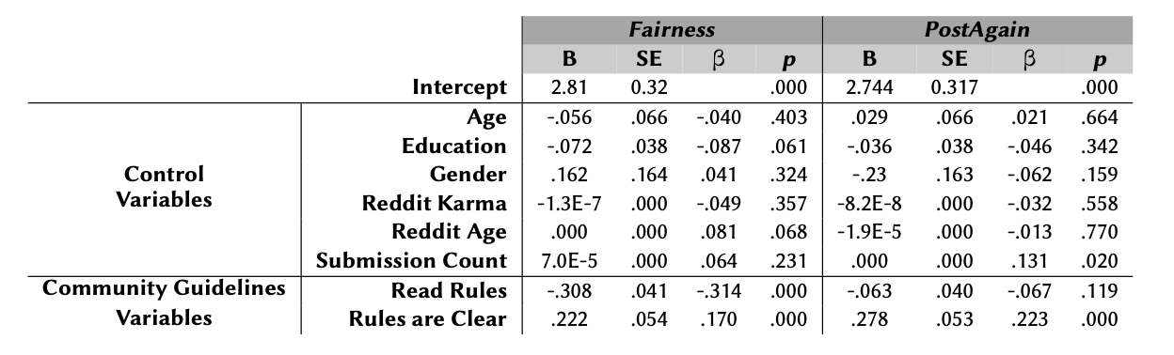

Slide 105
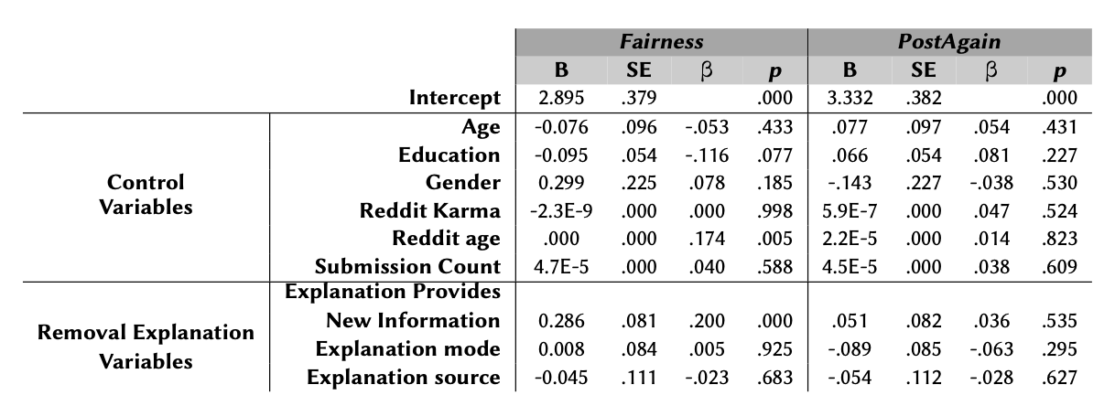

Slide 106
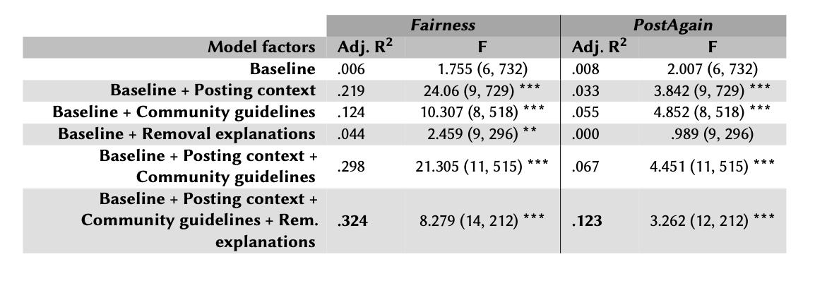

Slide 107
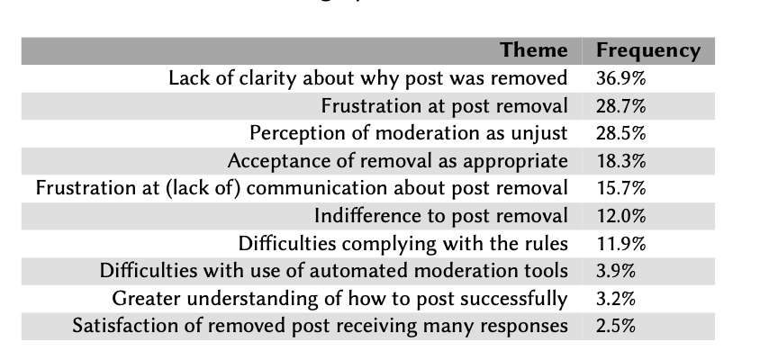

Slide 108
Explanations Paper

Slide 109
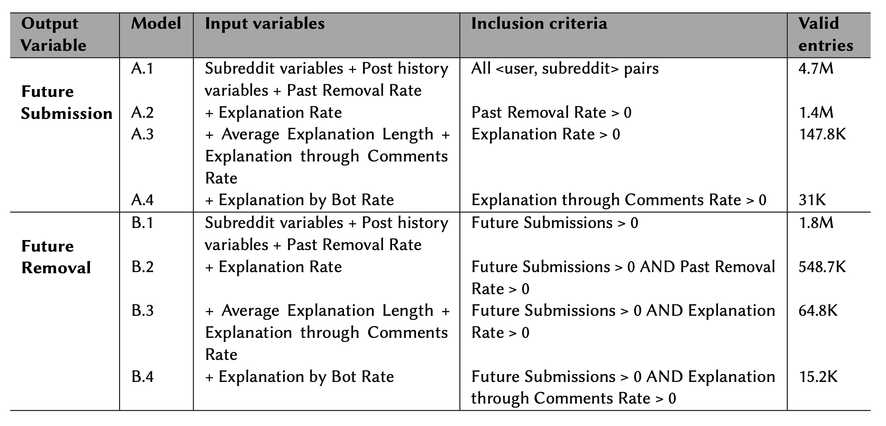
Notes:
I developed a series of regression models to test the effects of different aspects of removal explanations.
One of the values of this work is that we developed these models very carefully and we meticulously described many of the assumptions and simplifications we made in our modeling.

Slide 110
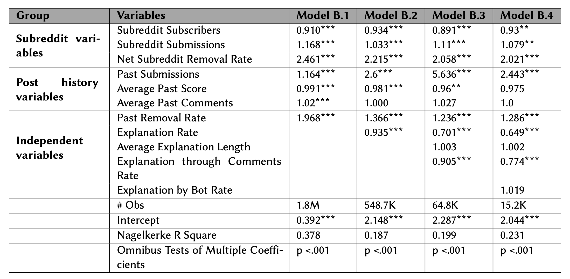
Regression Results – Future Removals

Slide 111
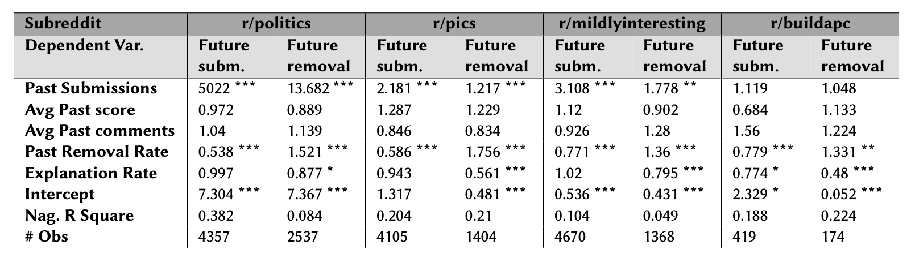
Subreddit Models

Slide 112
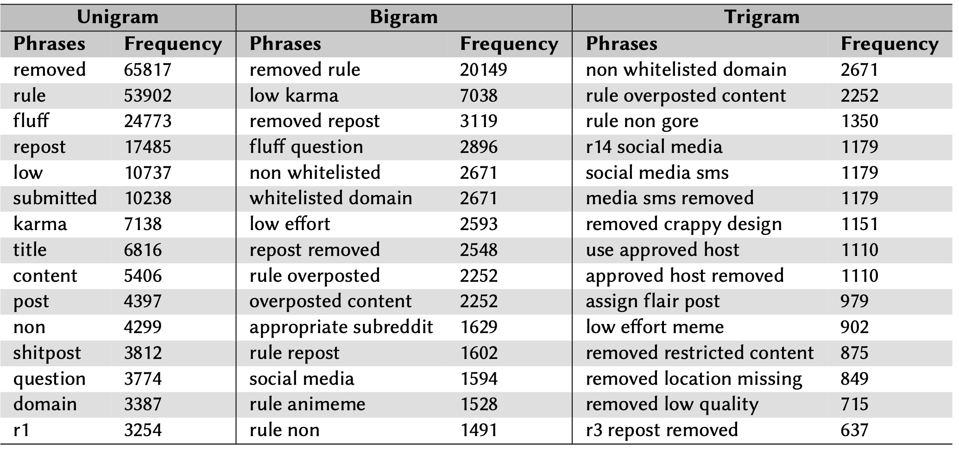
Explanation Flairs

Slide 113
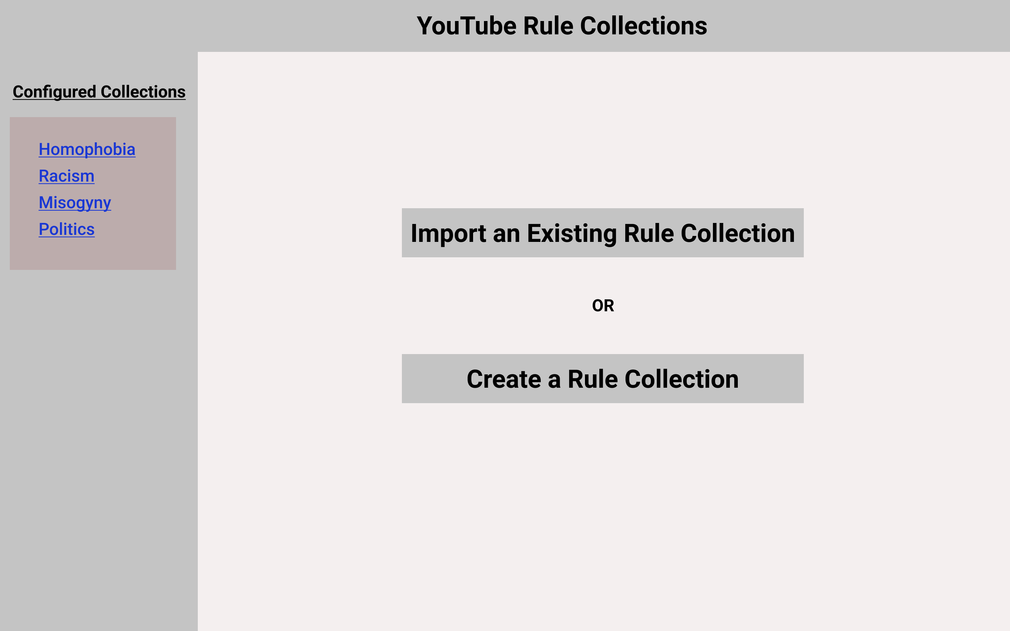

Slide 114
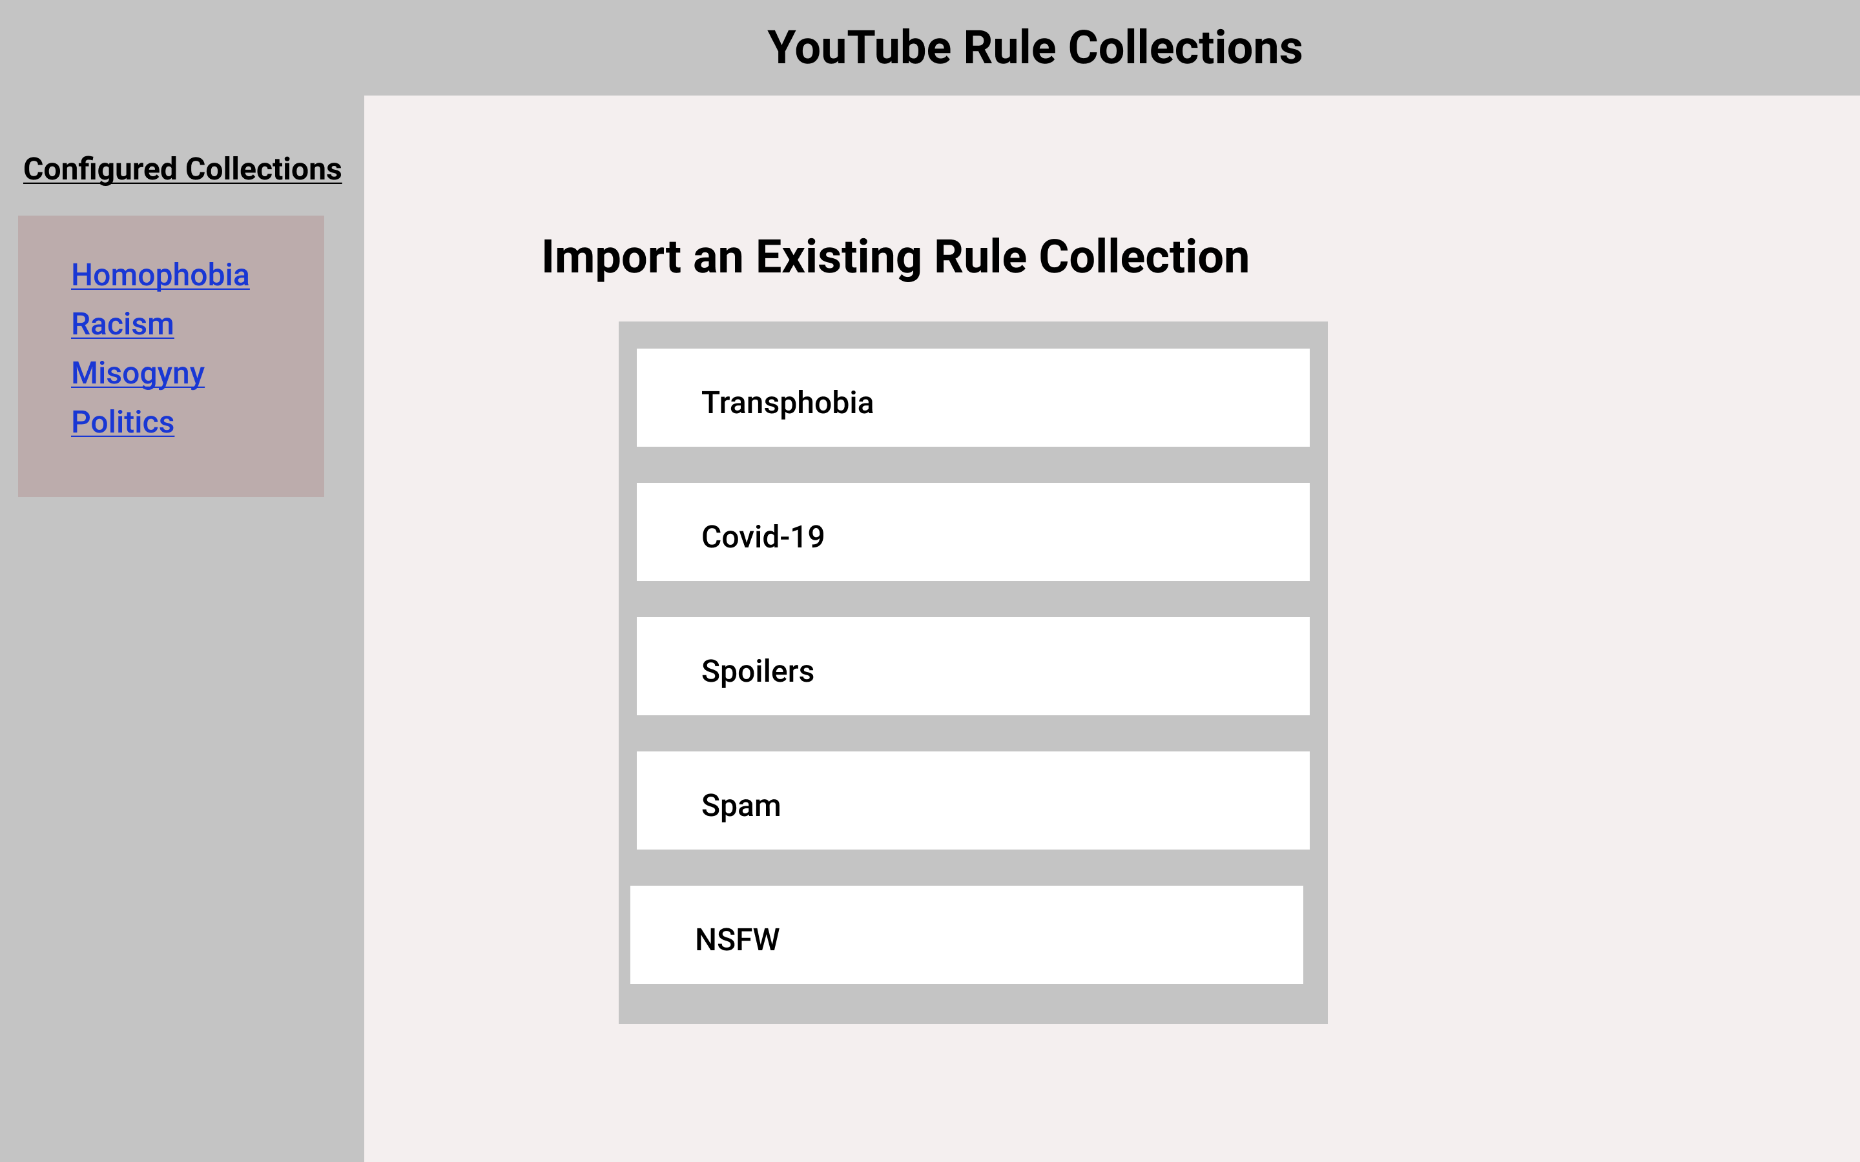

Slide 115
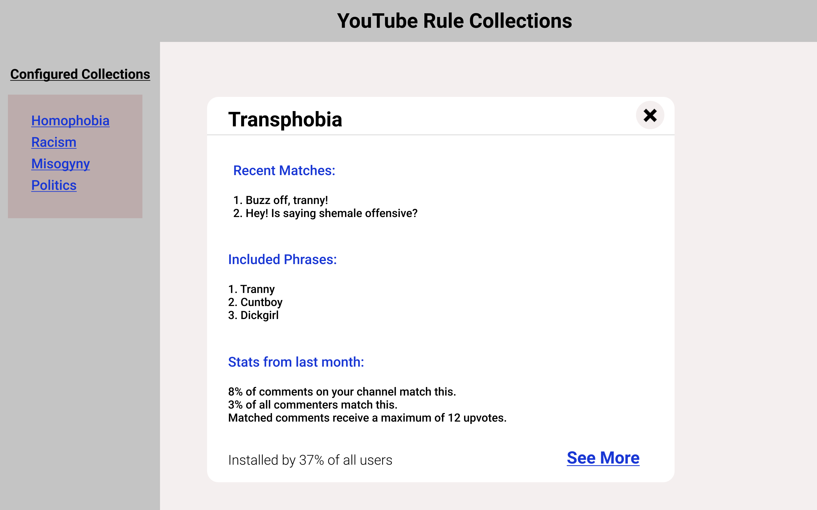

Slide 116
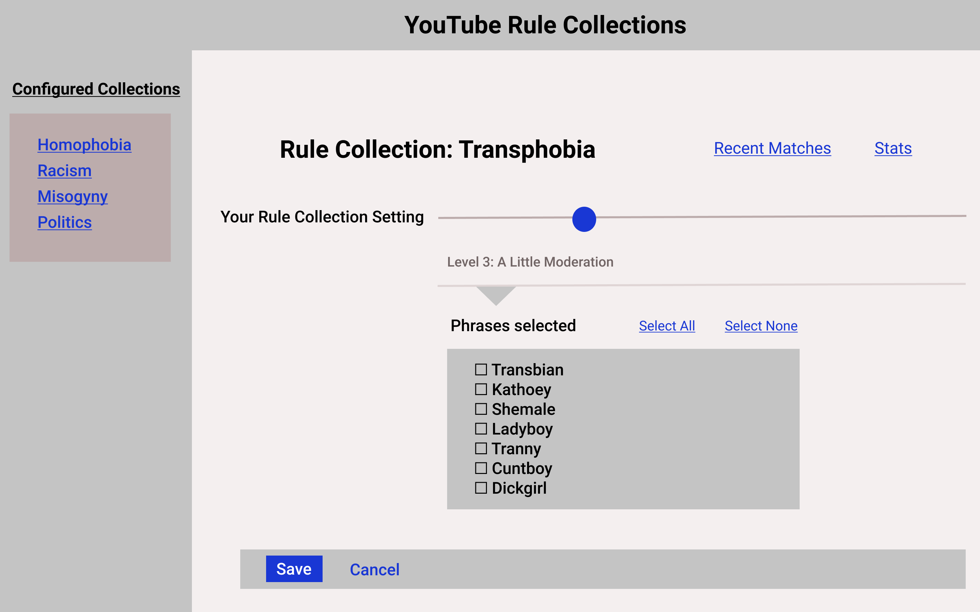

Slide 117
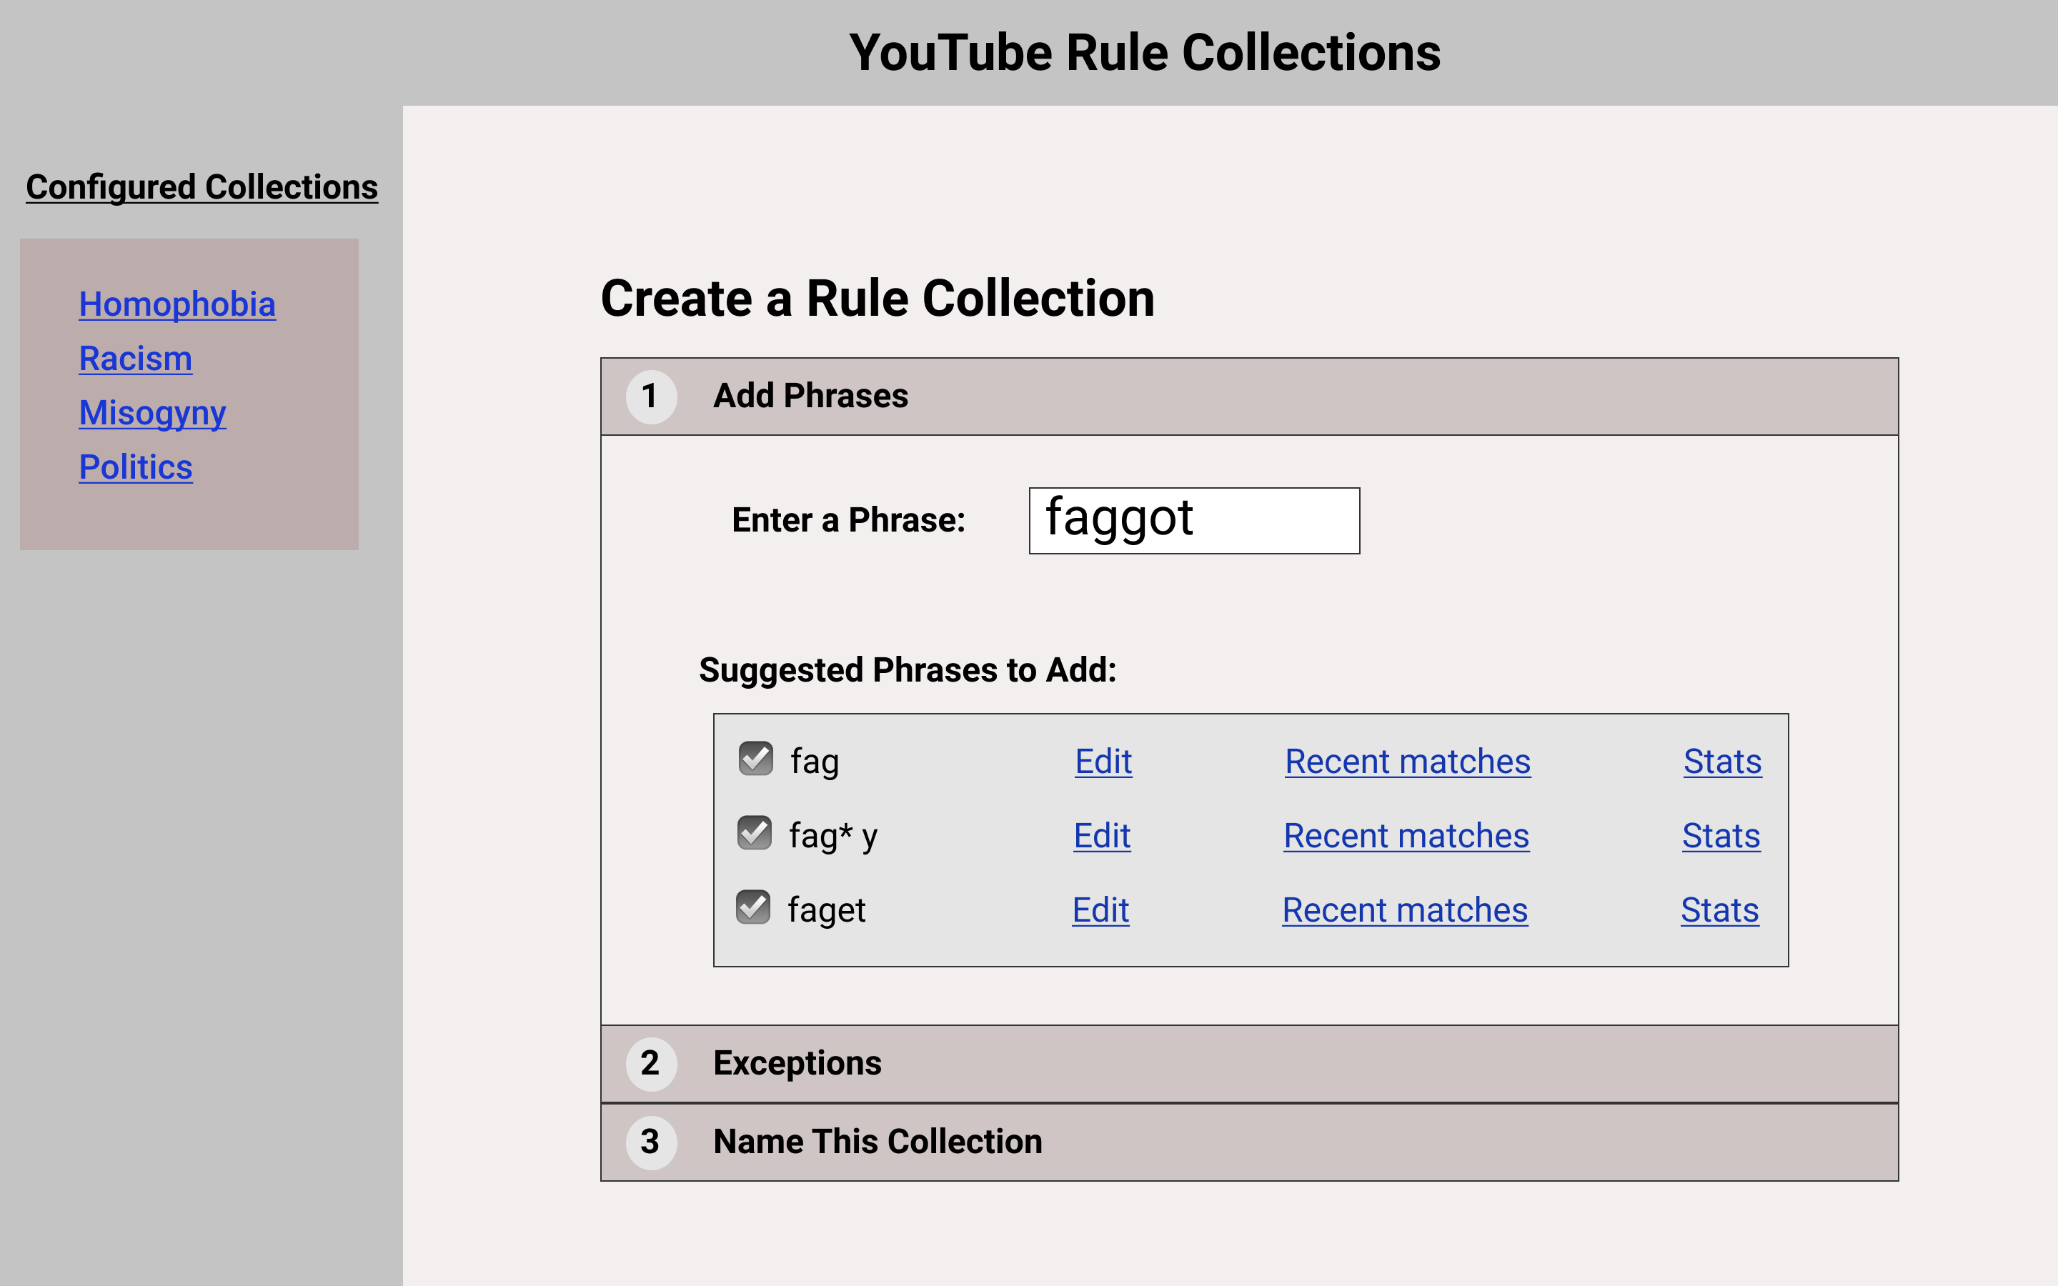

Slide 118
Subreddits I have moderated
Youtubers
Justiceserved
Bibliographies
Science
Onejob

Slide 119
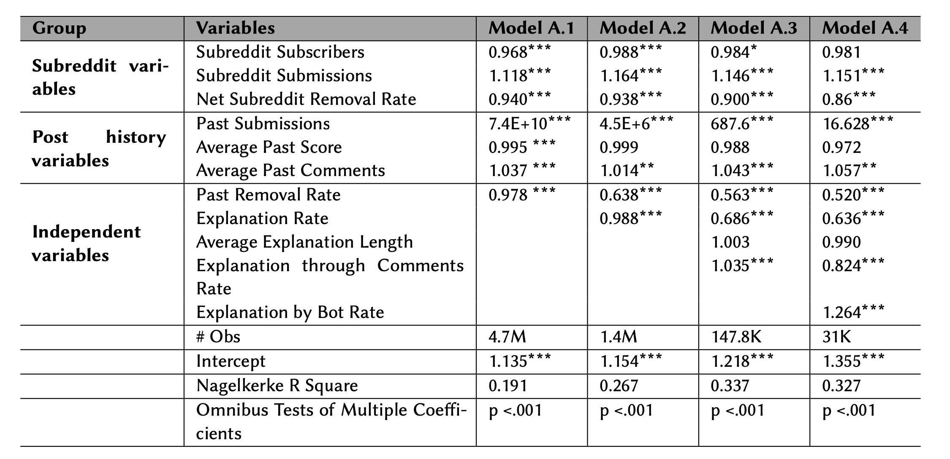
Regression Results – Future Submissions

Slide 120
Reporting the results
Odds ratios percentage
Percentage change in the odds of DV when an IV is increased by one SD

